Slide 1
Presentation on “GSOC”
Under the Guidance of:
MR. P.K Mishra
(Asst. Professor)
Dept. of CSE
Submitted By:
Siddharth Verma(1612810099)
Upasana Kumari(1612810096)
Dept. of CSE
DR. A.P.J. ABDUL KALAM TECHNICAL UNIVERSITY, LUCKNOW
March, 2020

Slide 2
Contents
S.No. | Title
1. | Abstract
2. | Literature Review
3. | Problem Description Existing Problem Proposed Solution
4. | Overall Block Diagram
5. | Implementation
6. | Performance Analysis
7. | Outputs
8. | Conclusion

Slide 3

GESTURE | SECURITIES OPERABLE CONTROLS
LETS START THE PRESENTATION OFFICIALLY

Slide 4
ABSTRACT

Slide 5
ABSTRACT
Developed as a cross platform desktop application, Gesture Securities Operable Controls [GSOC] is a application which is implemented with electron framework with google sheets as database. The project’s main aim is to provide a desktop application which makes use of the webcam to provide security with the help of face detection, media player gesture control and mouse control.
The project stack is build on electron framework which is a flavor of javascript which implements frontend with javascript, Node.js, bootstrap. The stack business logic is created on python and database is google sheet with the help of google apis.

Slide 6
LITERATURE
REVIEW

Slide 7
LITERATURE REVIEW
The Need
01
The system with web cam can be used for gesture recognition. Previous model lacked accuracy. But with trained dataset the results are better.
Previous Model
02
The previous model made use of openCv but the current implementation makes use of tensorflow model to provide classes to predict result.
The Outcome
03
Implementing the application will make use of the potential of a system providing with very well serving utilities.

Slide 8
Problem Description

Slide 9
Existing
Problem
Proposed
Solution
1. Lack use of webcam
2. Use of ML with system utilities
3. No Desktop Application available to Provide the requirements.
4. Cross Platform Application
5. Accuracy and Preciseness
1. Use Webcam to its fullest
2. Use of ML
3. A desktop application to deal with the Necessity
4. Use Electron framework to create a cross platform application
5. Provide better result with trained data

Slide 10
Block Diagram

Slide 11
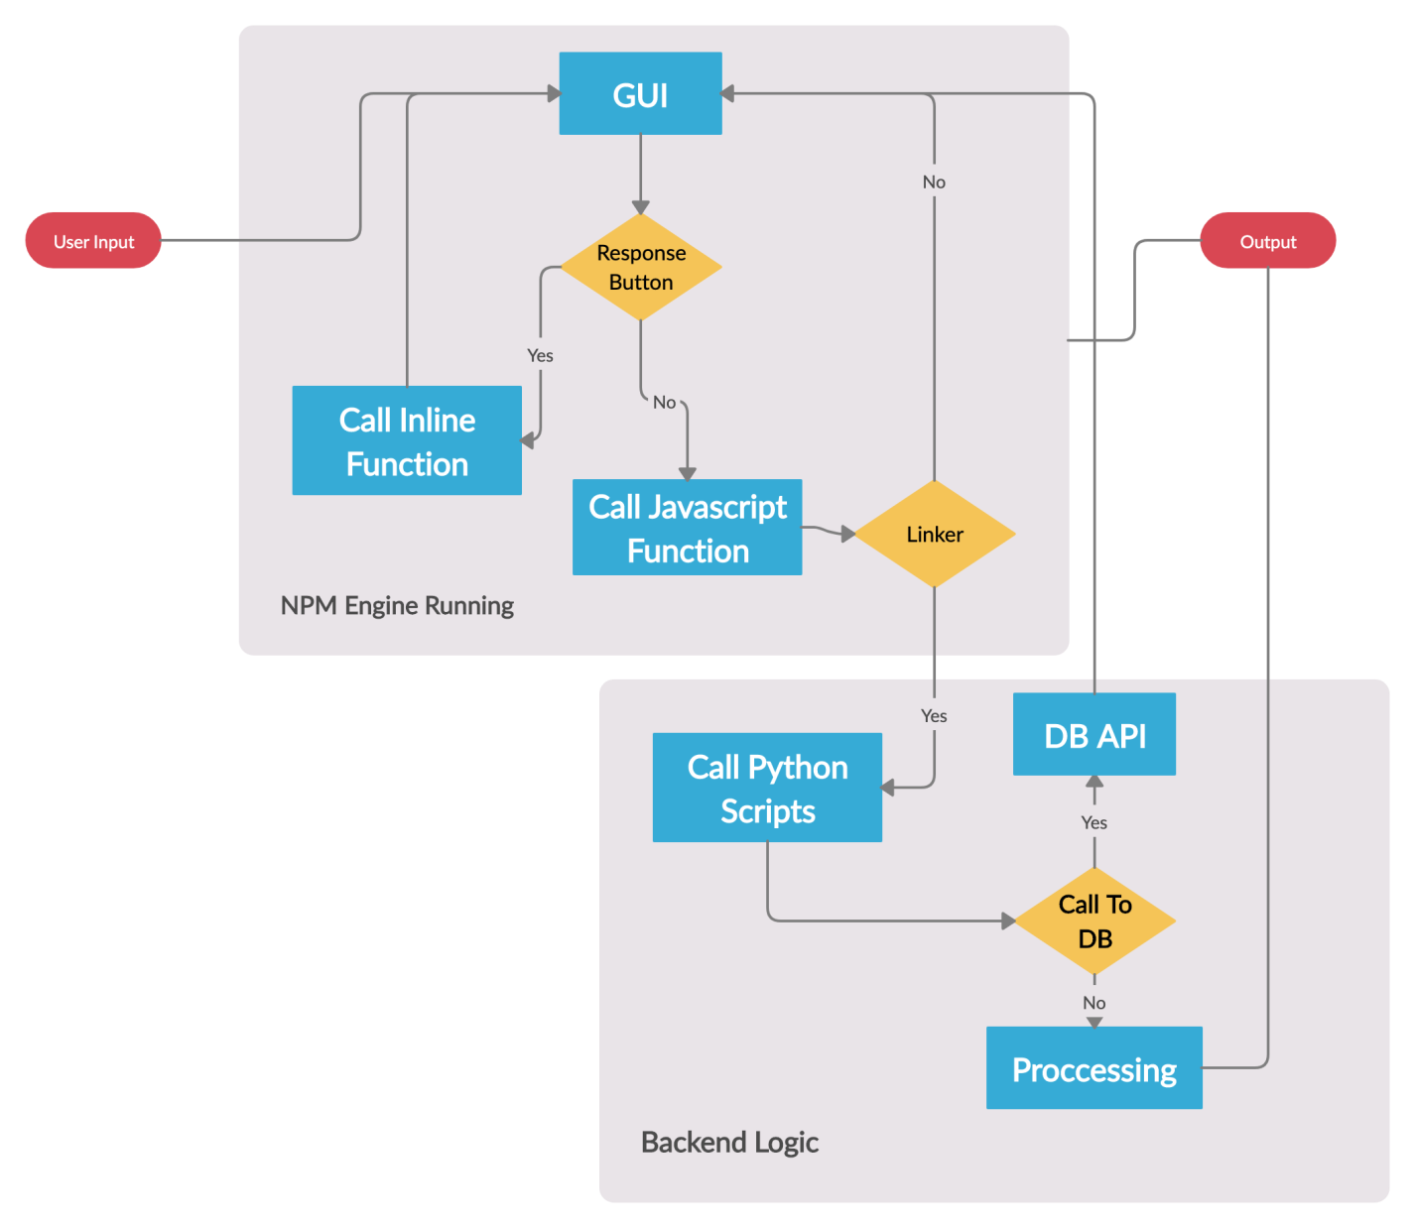

Slide 12
IMPLEMENTATION

Slide 13
Implementation
Installing Requirements
For the project the following requirement where installed
Python 3
Anaconda
Tensorflow
Node-js
Npm python-shell
Electron
Pip install gsheet oauthclient
Google Api

Slide 14
Implementation
Creating GUI
The GUI for the cross platform Desktop is implemented on node.js, javascript, bootstrap on top. This technology is help to create a GUI which is platform and environment independent that is it can also be run as a web application with minor changes.
Creating Python
Scripts
The Python scripts that are created are build for different purposes like gesture recognition, user data upload to DB.

Slide 15
Implementation
Creating DB
Using google sheet as DB. Creating a project at google repository, creating a user and generating credentials for accessing the google api
Creating linkers using javascript to bind the GUI with the python scripts
Linkers
Running npm engine
Run the npm engine to create the desktop application.
Based on the user input and processing we get the output.
Output

Slide 16
PERFORMANCE
ANALYSIS

Slide 17
Performance Analysis
60%
50%
Of total test cases run
Successfully ran on all platform except (kali, parrot)
Of accuracy received on the gesture recognition model.
80%
40%
Of test cases failed were due to database connection and background noise cancellation.
Of Application crashed were reached at the threshold of 182 rps.

Slide 18
OUTPUTS

Slide 19
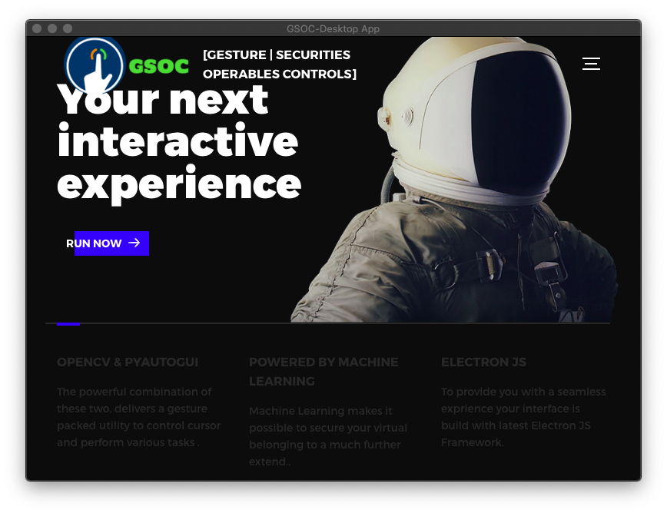
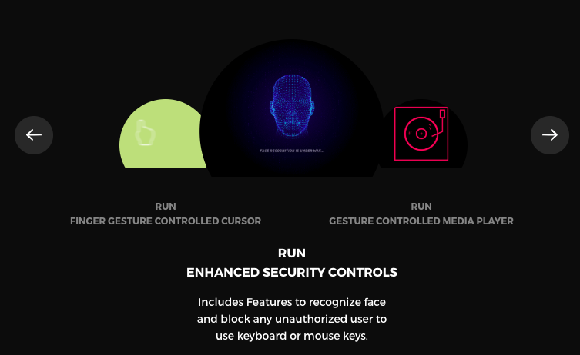
MAIN PAGE OF GUI
PROVIDED UTILITIES

Slide 20
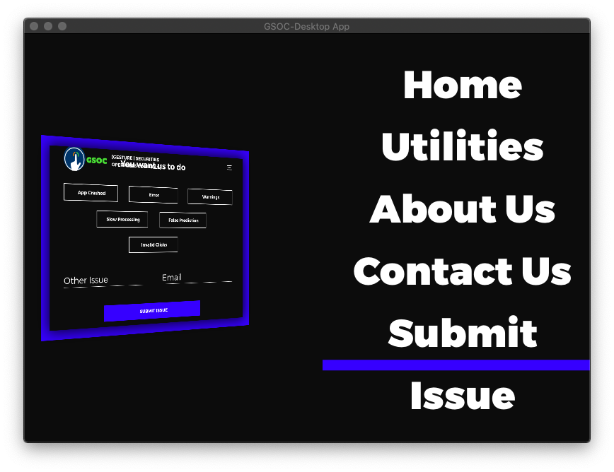
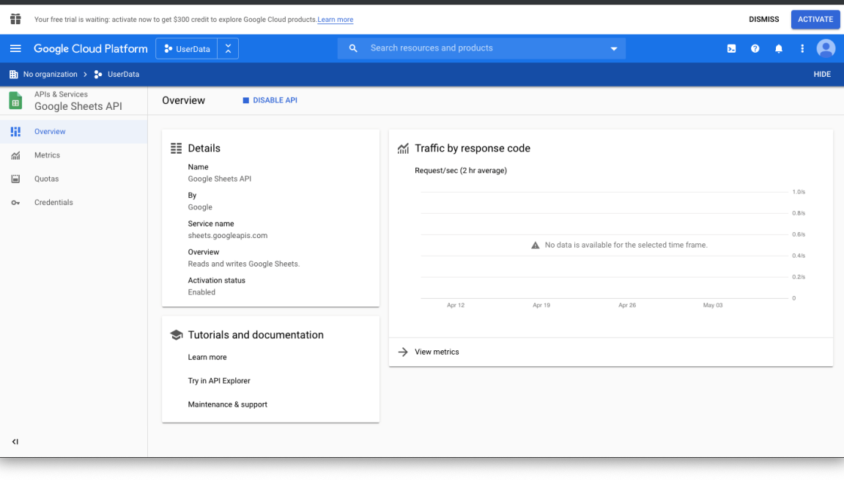
DYNAMIC GUI DISPLAY
API REQUEST PORTAL

Slide 21
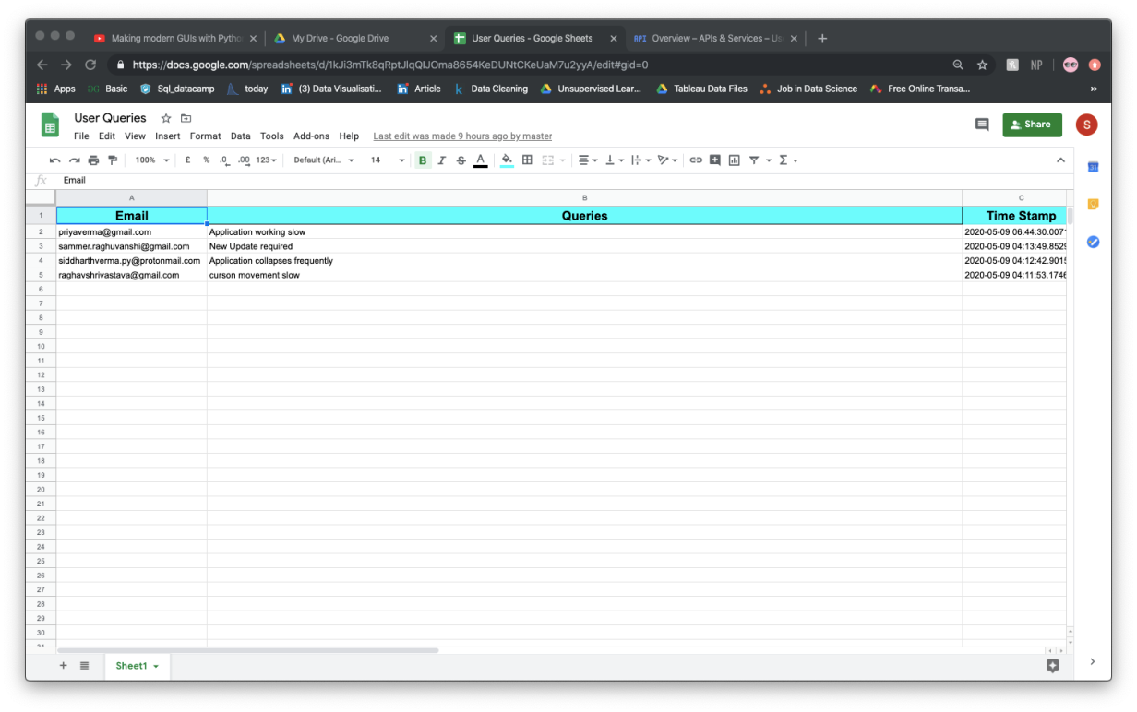
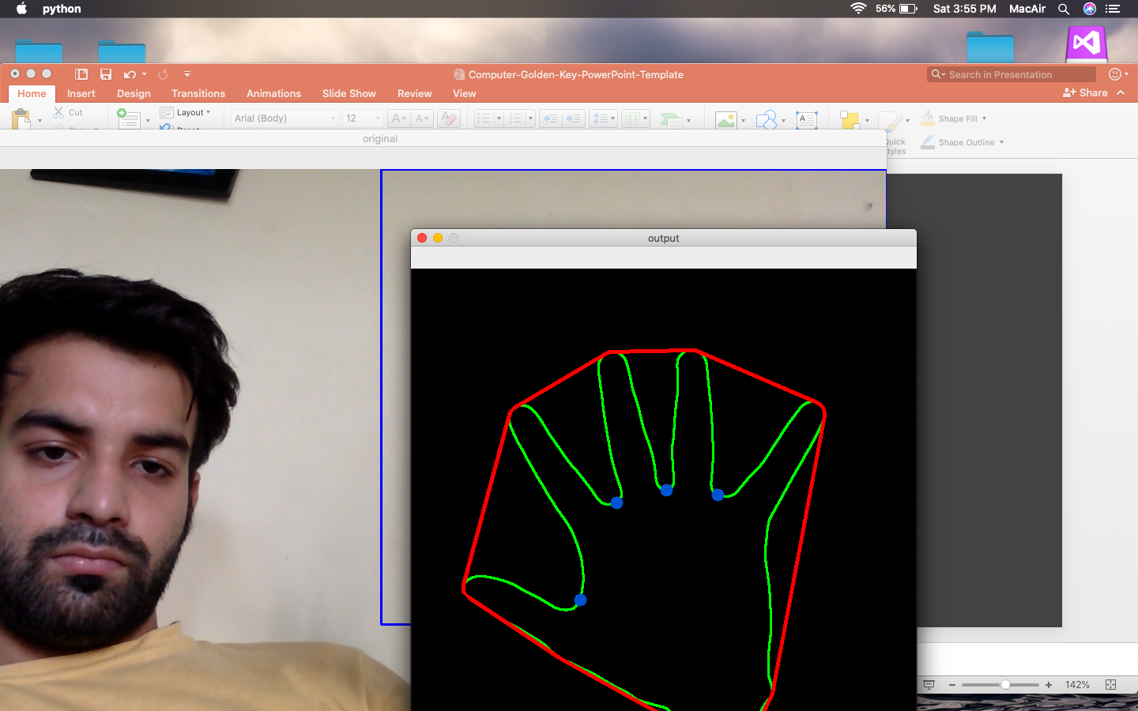
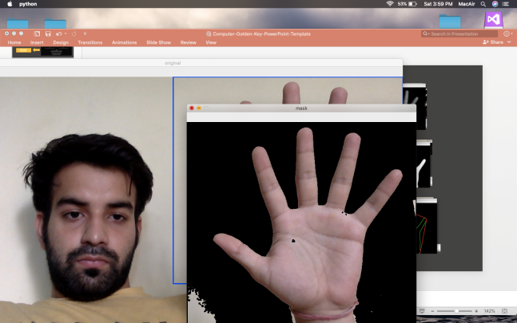
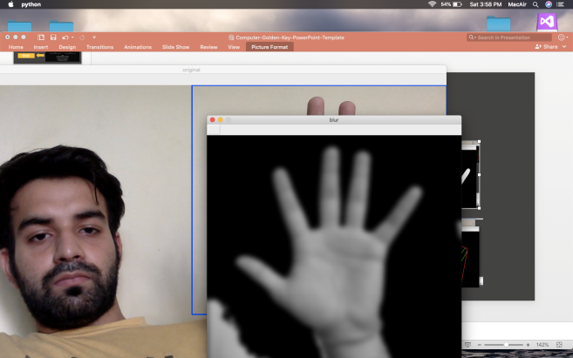
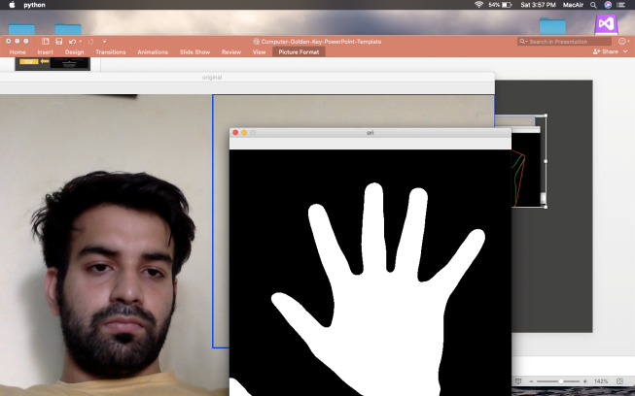
USER DB
Process

Slide 22
CONCLUSION

Slide 23
CONCLUSION
The Need
01
The system with web cam can be used for gesture recognition. With more advancement the utility of old system can be brought back into use.
More Ease
02
With the implementation, ppt, slideshow, media player can be control by gestures.
03
The accuracy of the application can be made better by more training.

Slide 24
Thank you

